Slide 1
Intellectual Property - Trade Secrets
Iowa Academy of Trial Lawyers
2021 Annual Meeting
February 24, 2021
Glenn Johnson
Jonathan Kennedy

Slide 2


Intellectual Property - Trade Secrets
Jonathan Kennedy
Glenn Johnson

Slide 3
Trade Secret Value
Publicly trade companies have an estimated $___________ worth of trade secrets?
(a) $20 billion (b) $800 billion
(c) $5 trillion (d) $10 trillion

Slide 4
Trade Secret Value
Publicly trade companies have an estimated $___________ worth of trade secrets?
(a) $20 billion (b) $800 billion
(c) $5 trillion (d) $10 trillion
Source: Congressional Research Service, “Protection of Trade Secrets: Overview of Current Law and Legislation” p. 13 (April 22, 2016) (citing U.S. Chamber of Commerce, “The Case for Enhanced Protection of Trade Secrets in the Trans-Pacific Partnership Agreement,” at 10), available at https://www.fas.org/sgp/crs/secrecy/R43714.pdf.

Slide 5
Trade Secret Theft
“U.S. companies annually suffer billions of dollars in losses due to the theft of their trade secrets by employees, corporate competitors, and even foreign governments. Stealing trade secrets has increasingly involved the use of cyberspace, advanced computer technologies, and mobile communication devices, thus making the theft relatively anonymous and difficult to detect.”
Source: Congressional Research Service, “Protection of Trade Secrets: Overview of Current Law and Legislation”, at “Summary” (April 22, 2016).

Slide 6
Trade Secret Theft
Loss attributable to trade secret theft is estimated to be between 1-3% of U.S. Gross Domestic Product.
Source: PricewaterhouseCooper & Center for Responsible Enterprise and Trade (CREATe.org), “Economic Impact of Trade Secret Theft: A Framework for Companies to Safeguard Trade Secrets and Mitigate Potential Threats,” at 3 (February 2014), available at http://www.pwc.com/en_US/us/forensic-services/publications/assets/economic-impact.pdf

Slide 7
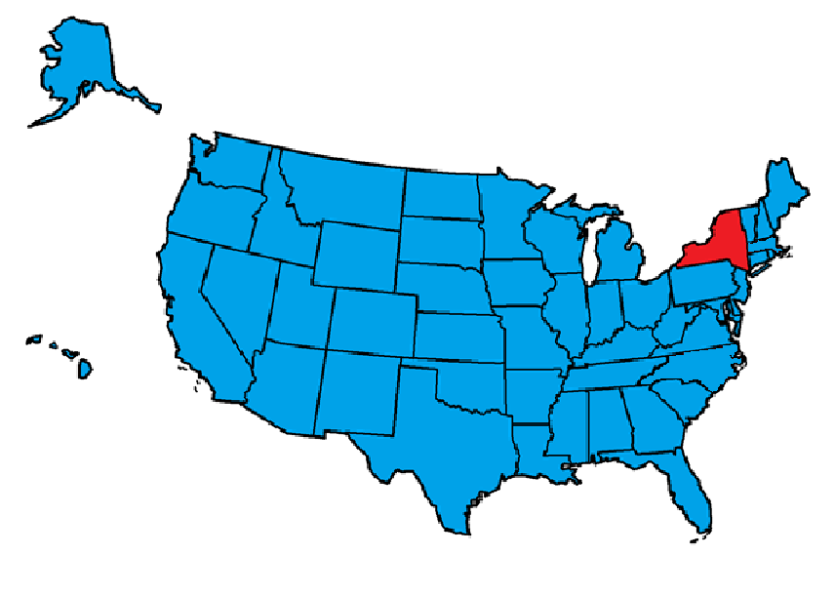
Trade Secret Protection
Basis of Protection
State
All 50 states have a Trade Secret Statute
49 are based on the Uniform Trade Secret Act (UTSA)
Exceptions:
New York
Massachusetts adopted the UTSA recently.

Slide 8
Trade Secret Protection
Uniform Trade Secret Act’s Definition
Uniform Trade Secret Act of 1985 § 1
(4) “Trade secret” means information, including a formula, pattern, compilation, program, device, method, technique, or process, that:
(i) derives independent economic value, actual or potential, from not being generally known to, and not being readily ascertainable by proper means by, other persons who can obtain economic value from its disclosure or use, and
(ii) is the subject of efforts that are reasonable under the circumstances to maintain its secrecy.

Slide 9

Trade Secret Protection
Basis of Protection
Federal
Trade Secrets Act of 1948
18 U.S.C. § 1905
Forbids federal government employees and contractors from unauthorized disclosure of government information
Penalty:
Removal from office/employment
Fine
Imprisonment (not greater than 1 year)

Slide 10
Trade Secret Protection
Basis of Protection
Federal
The Economic Espionage Act of 1996
18 U.S.C. §§ 1831-1839
Definition similar to UTSA
Focus: Criminal
Created Federal two Federal Criminal Offenses:
§ 1831: Trade secret theft to benefit a foreign entity (economic espionage)
§ 1832: Trade secret theft intended to benefit another party

Slide 11
Trade Secret Protection
Basis of Protection
Federal
Defend Trade Secrets Act of 2016
Amended the EEA
18 U.S.C. § 1836
Definition still similar to UTSA
Created a federal civil cause of action for trade secret misappropriation

Slide 12
Trade Secret Protection
18 U.S.C. § 1839(3) (2016)
“trade secret” means all forms and types of financial, business, scientific, technical, economic, or engineering information, including patterns, plans, compilations, program, devices, formulas, designs, prototypes, methods, techniques, processes, procedures, programs, or codes, whether tangible or intangible, and whether or how stored, compiled, or memorialized physically, electronically, graphically, photographically, or in writing if--
(A) the owner thereof has taken reasonable measures to keep such information secret; and
(B) the information derives independent economic value, actual or potential, from not being generally known to, and not being readily ascertainable through proper means by, another person who can obtain economic value from the disclosure or use of the information.

Slide 13
Trade Secret Misappropriation
18 U.S.C. § 1836(b)(1) (2016)
“An owner of a trade secret that is misappropriated may bring a civil action under this subsection if the trade secret is related to a product or service used in, or intended for use in, interstate or foreign commerce.”

Slide 14
Trade Secret Misappropriation
18 U.S.C. § 1839(5)(A)-(B) (2016)
Two Types of Misappropriation:
Acquisition
Disclosure or Use
Note: These are two independent theories that you can plead

Slide 15
Trade Secret Misappropriation
18 U.S.C. § 1839(5)(A) (2016)
Misappropriation by Acquisition
“Acquisition of a trade secret of another by a person who knows or has reason to know that the trade secret was acquired by improper means”

Slide 16
Trade Secret Misappropriation
18 U.S.C. § 1839(5)(B) (2016)
Misappropriation by Disclosure or Use
“disclosure or use of a trade secret of another without express or implied consent by a person who--
(i) used improper means to acquire knowledge of the trade secret;
(ii) at the time of disclosure or use, knew or had reason to know that the knowledge of the trade secret was--
(I) derived from or through a person who had used improper means to acquire the trade secret;
(II) acquired under circumstances giving rise to a duty to maintain the secrecy of the trade secret or limit the use of the trade secret; or
(III) derived from or through a person who owed a duty to the person seeking relief to maintain the secrecy of the trade secret or limit the use of the trade secret; or
(iii) before a material change of the position of the person, knew or had reason to know that--
(I) the trade secret was a trade secret; and
(II) knowledge of the trade secret had been acquired by accident or mistake.”

Slide 17
Trade Secret Misappropriation
18 U.S.C. § 1839(6) (2016)
Improper Means
Theft
Bribery
Misrepresentation
Breach or inducement of a breach of a duty to maintain secrecy
Espionage through electronic or other means

Slide 18
Trade Secret Misappropriation
18 U.S.C. § 1839(6) (2016)
Improper Means
Does not include
Reverse Engineering
Independent derivation
Any other lawful means of acquisition

Slide 19
Trade Secret Misappropriation
18 U.S.C. § 1833(b) (2016)
Exceptions
Government Disclosure (Whistleblower Provision)
No civil or criminal liability for disclosure made in confidence to government official or attorney for purpose of reporting suspected illegal activity

Slide 20
Trade Secret Misappropriation
18 U.S.C. § 1833(b) (2016)
Exceptions
Court Disclosure
Is filed in a court document, e.g., complaint, under seal.

Slide 21
Trade Secret Misappropriation
18 U.S.C. § 1833(b) (2016)
Exceptions
Retaliation Lawsuit
Individual filing a lawsuit against employer for retaliation of whistleblowing may disclose the trade secret to her attorney, use the trade secret information under seal in the court proceeding, and not disclose the trade secret otherwise.

Slide 22
Trade Secret Misappropriation
18 U.S.C. § 1836(b) (2016)
Remedies
Injunction
Ex parte seizure
Attorneys Fees
To prevailing party
For bad faith action
Damages
Actual
Unjust enrichment
Reasonable royalty
Exemplary damages (doubling award) for willful and malicious misappropriation

Slide 23
Trade Secret Misappropriation
18 U.S.C. § 1836(d) (2016)
Statute of Limitations
“A civil action under subsection (b) may not be commenced later than 3 years after the date on which the misappropriation with respect to which the action would relate is discovered or by the exercise of reasonable diligence should have been discovered. For purposes of this subsection, a continuing misappropriation constitutes a single claim of misappropriation.”
- See e.g., CMI Road Building, Inc. v. Iowa Parts, Inc., 920 F.3d 560 (8th Cir. 2019).

Slide 24
DTSA’s Relationship with State Laws
18 U.S.C. § 1838 (2016)
“Except as provided in section 1833(b), this chapter shall not be construed to preempt or displace any other remedies, whether civil or criminal, provided by United States Federal, State, commonwealth, possession, or territory law for the misappropriation of a trade secret, or to affect the otherwise lawful disclosure of information by any Government employee under section 552 of title 5 (commonly known as the Freedom of Information Act).”

Slide 25
DTSA’s Relationship with State Laws
Supplemental Jurisdiction § 1367(a)
Supplemental jurisdiction pursuant to 28 U.S.C. § 1367(a) can apply for the state law claims.
A separate state law claim of trade secret misappropriation can also be raised alongside the claim under DTSA.
- See, e.g., Mission Measurement Corp. v. Blackbaud, Inc., 216 F. Supp. 3d 915, 916 (N.D. Ill. Oct. 27, 2016).

Slide 26

Iowa Code § 550
Statute of Limitations (§ 550.8)
Three years
“after the misappropriation is discovered or should have been discovered by the exercise of reasonable diligence.”
Injunction (§ 550.3)
Available for actual or threatened
misappropriation
Damages (§ 550.4)
Actual loss and unjust enrichment or
Reasonable royalty
Attorneys Fees (§ 550.6)
Bad faith or malicious conduct

Slide 27

Preemption of other claims?
Iowa
No preemption under Iowa Act
But be wary if asserting a claim outside of Iowa or based upon foreign law

Slide 28

Preemption of other claims?
Nebraska
no preemption under Nebraska Act

Slide 29

Preemption of other claims?
Illinois
Statute preempts common law tort claims based upon misappropriation of confidential information that does not rise to the level of a “trade secret.” Thomas & Betts Corp. v. Panduit Corp., 108 F. Supp.2d 968, 971 (N.D. Ill. 2000)

Slide 30

Preemption of other claims?
Wisconsin
Statute only preempts other remedies based upon misappropriation of “trade secrets,” and leaves untouched any other common law remedies based upon confidential information or theft of information. Burbank Grease Servs., LLC v. Sokolowski, 717 N.W.2d 781, 789 (Wis. 2006))

Slide 31
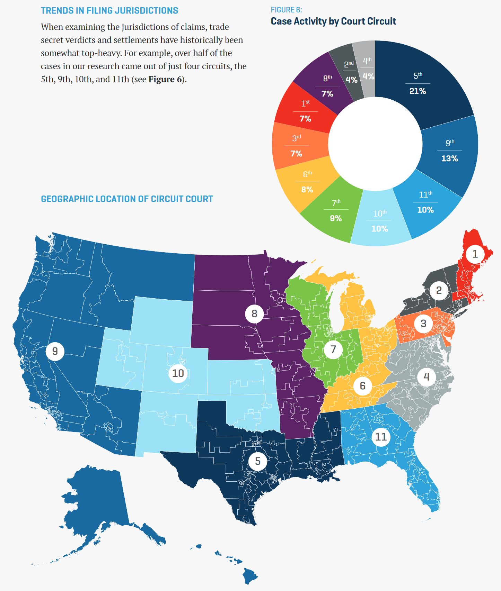
Trade Secret Case Filing Trends
https://www.winston.com/images/content/2/0/v2/203824/trends-in-trade-secret-litigation-report-2020.pdf

Slide 32
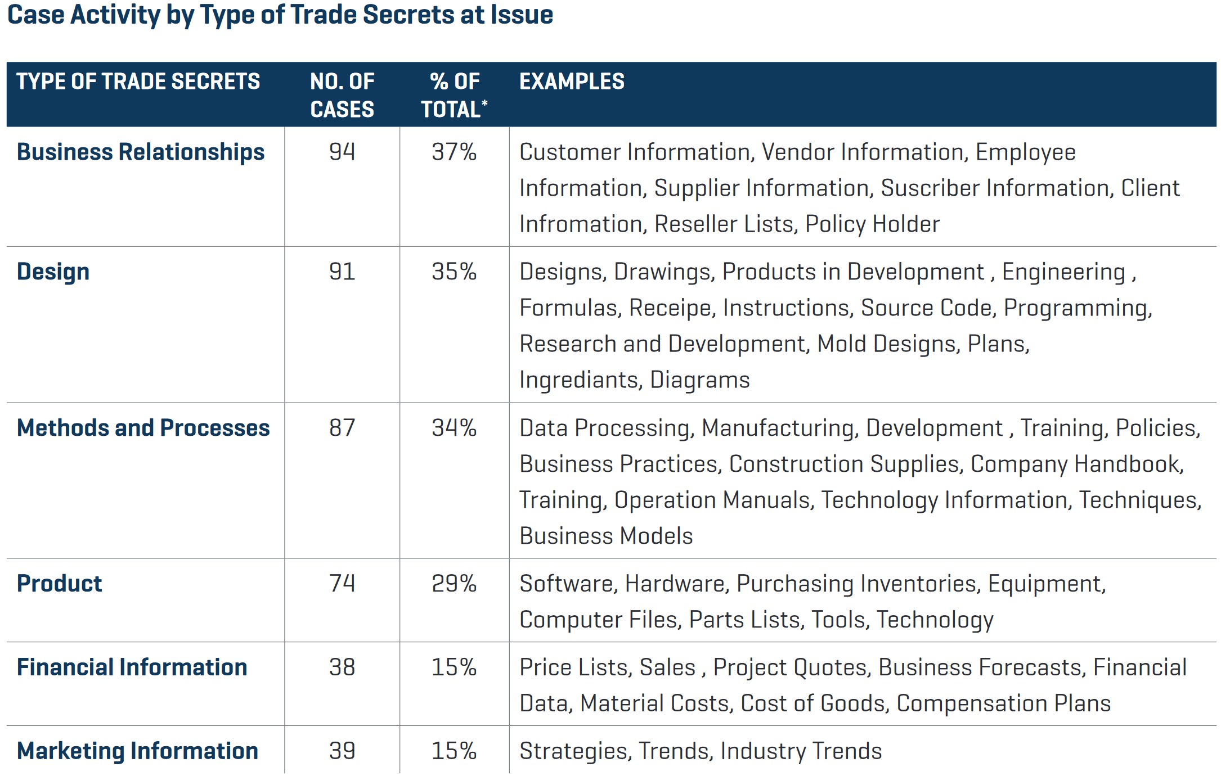
Trade Secret Case Filing Trends
https://www.winston.com/images/content/2/0/v2/203824/trends-in-trade-secret-litigation-report-2020.pdf

Slide 33
Trade Secret – Filing Considerations
Factual Considerations
Desire to obtain seizure?
Better for multi-jurisdictional cases
Might be better suited for cases involving foreign parties because DTSA contains extra-territorial clauses
In federal court expert witnesses will be subject to the Daubert standard
- See, e.g., Axis Steel Detailing, Inc. v. Prilex Detailing LLC, 2017 U.S. Dist. LEXIS 221339 (D. Utah June 29, 2017) (delineating the elements of an ex parte seizure order under the DTSA).

Slide 34
Trade Secret – Filing Considerations
Federal Question
Do you have sufficient facts to satisfy interstate commerce or foreign commerce requirement in 18 U.S.C. § 1836(b)(1)?
- See, e.g., Frank N. Magid Assocs. v. Marrs, 2017 U.S. Dist. LEXIS 113702, *4 (N.D. Iowa July 20, 2017) (holding that the federal district court had original subject matter jurisdiction over the DTSA claim due to it being a federal question pursuant to 28 U.S.C. § 1331).

Slide 35
Trade Secret – Filing Considerations
Federal Pleading Standard
Do you have sufficient information to satisfy the federal pleading standard, i.e., Twombly and Iqbal?

Slide 36
Trade Secret – Filing Considerations
Federal Pleading Standard
Various cases in 2016 faced motions to dismiss the federal trade secret claim under Twombly and Iqbal. See for example:
Mission Measurement Corp. v. Blackbaud, Inc., 216 F. Supp. 3d 915 (N.D. Ill. Oct. 27, 2016) (NOT DISMISSED).
Adams Arms, LLC v. Unified Weapons Sys., Inc., Case No. 8:16-cv-1503-T-33AEP, 2016 WL 5391394 (M.D. Fla. Sept. 27, 2016) (DISMISSED IN PART).
HealthBanc Int’l, LLC v. Synergy Worldwide, Inc., 208 F. Supp. 3d 1193 (D. Utah Sept. 22, 2016) (DISMISSED).
M.C. Dean, Inc. v. City of Miami Beach, Florida, 199 F. Supp. 3d 1349 (S.D. Fla. Aug. 8, 2016) (DISMISSED).

Slide 37
Trade Secret – Filing Considerations
Federal Pleading Standard
Mission Measurement Corp. v. Blackbaud, Inc., 216 F. Supp. 3d 915 (N.D. Ill. Oct. 27, 2016) (NOT DISMISSED).
Facts: Mission had proprietary database of over 75,000 data points categorized into 130 social outcome types for social program evaluations.
Mission entered Confidentiality and Non-Disclosure agreement with MicroEdge for a joint project where confidential information would be passed between companies
Blackbaud purchased MicroEdge
Blackbaud through MicroEdge independently released an outcomes database that was based on Mission’s proprietary information provided throughout the joint project

Slide 38
Trade Secret – Filing Considerations
Federal Pleading Standard
Mission Measurement Corp. v. Blackbaud, Inc., 216 F. Supp. 3d 915 (N.D. Ill. Oct. 27, 2016) (NOT DISMISSED).
Procedural History: Mission sued Blackbaud and MicroEdge for trade secret misappropriation under the DTSA and Illinois Trade Secret Act (“ITSA”).
Defendants moved to dismiss for lack of sufficient particularity and failure to state a claim which can be granted.

Slide 39
Trade Secret – Filing Considerations
Federal Pleading Standard
Mission Measurement Corp. v. Blackbaud, Inc., 216 F. Supp. 3d 915 (N.D. Ill. Oct. 27, 2016) (NOT DISMISSED).
Court held that the sufficiency had been satisfied under ITSA and 7th Circuit precedent.
“Courts . . . have concluded trade secret ‘allegations to be adequate in instances where the information and the efforts to maintain its confidentiality are described in general terms.’ . . . [T]rade secrets ‘need not be disclosed in detail in a complaint alleging misappropriation for the simple reason that such a requirement would result in public disclosure of the purported trade secrets.’” Mission, at 920-21 (quoting Covenant Aviation Sec., LLC v. Berry, 15 F. Supp. 3d 813, 818 (N.D. Ill. 2014) (additional citations omitted)).

Slide 40
Trade Secret – Filing Considerations
Federal Pleading Standard
Adams Arms, LLC v. Unified Weapons Sys., Inc., Case No. 8:16-cv-1503-T-33AEP, 2016 WL 5391394 (M.D. Fla. Sept. 27, 2016) (DISMISSED IN PART).
Facts: Adams Arms has numerous alleged trade secrets for making high powered firearms including, for example, “specific manufacturing processes, the tools and machinery used to make the parts, the mix of particular part types and sizes, and the mix of particular vendors for pricing for certain parts.”
Has employees and third-parties sign non-disclosure agreements among other measures to maintain secrecy.
Adams Arms and Unified Weapons entered a non-disclosure and letter of intent for the companies to work together.
Unified Weapons submitted a bid using Adam Arms’ designs, procedures, and specifications.
Unified Weapons won the bid in 2015.

Slide 41
Trade Secret – Filing Considerations
Federal Pleading Standard
Adams Arms, LLC v. Unified Weapons Sys., Inc., Case No. 8:16-cv-1503-T-33AEP, 2016 WL 5391394 (M.D. Fla. Sept. 27, 2016) (DISMISSED IN PART).
Adams Arms sued including claims under the DTSA and Florida Trade Secrets Act
Adams Arms asserted DTSA claims based on both acquisition and disclosure theories pursuant to 18 U.S.C. § 1839(5)
Notably the alleged misappropriation based on acquisition took place before the DTSA was entered.
Unified Weapons sought dismissal arguing that the statute requires a continuing misappropriation or misappropriation after the DTSA was effective.

Slide 42
Trade Secret – Filing Considerations
Federal Pleading Standard
Adams Arms, LLC v. Unified Weapons Sys., Inc., Case No. 8:16-cv-1503-T-33AEP, 2016 WL 5391394 (M.D. Fla. Sept. 27, 2016) (DISMISSED IN PART).
Court notes that the acquisition misappropriation at best took place prior to the effective date and was not a continuing action. Thus, dismissing the claim based on misappropriation by acquisition.
Arguably Unified Weapons acquired the trade secrets through proper means.
The Court held that by fulfilling the purchase bid, Unified Weapons was possibly continuing misappropriation under the disclosure/use theory. Thus, misappropriation based on disclosure/use was not dismissed.

Slide 43
Trade Secret – Trial Considerations
Work with the Court Early On to Maintain Secrecy
Statute may provide for secret proceedings
See, e.g., Iowa Code § 550.7 (“preservation of secrecy”)
Check local rules and Judge’s preferences regarding sealed and redacted pleadings
Obtain Protective Order in case
Closed courtroom for hearings and trial

Slide 44
Questions?
Glenn Johnson
Jonathan Kennedy
Glenn.Johnson@ipmvs.com
Jonathan.Kennedy@ipmvs.com

